Slide 1
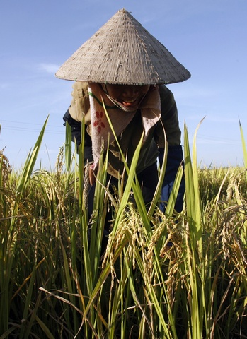
Partnerships for Development
Rubert Konijn
Agricultural Counsellor
Royal Netherlands Embassy

Slide 2
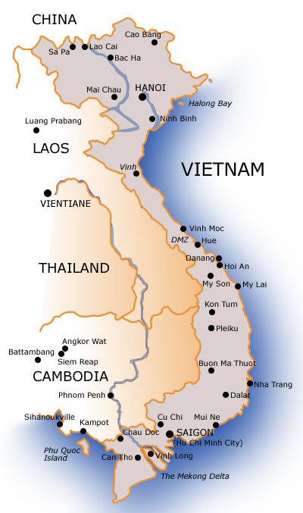
Content Presentation
Introduction
Development of Vietnam
Fast growth of agriculture, lessons learned
Public Private Partnerships

Slide 3
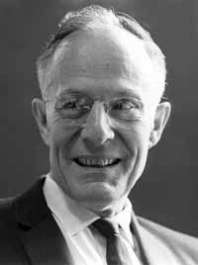
Agricultural development and poverty reduction
Theodore Schultz acceptance speech for the 1979 Nobel Prize in Economics
“Most of the people in the world are poor, so if we knew the economics of being poor we
would know much of the economics that really matters. Most of the world's poor people earn
their living from agriculture, so if we knew the economics of agriculture we would know much
of the economics of being poor” (Shultz, 1979).

Slide 4
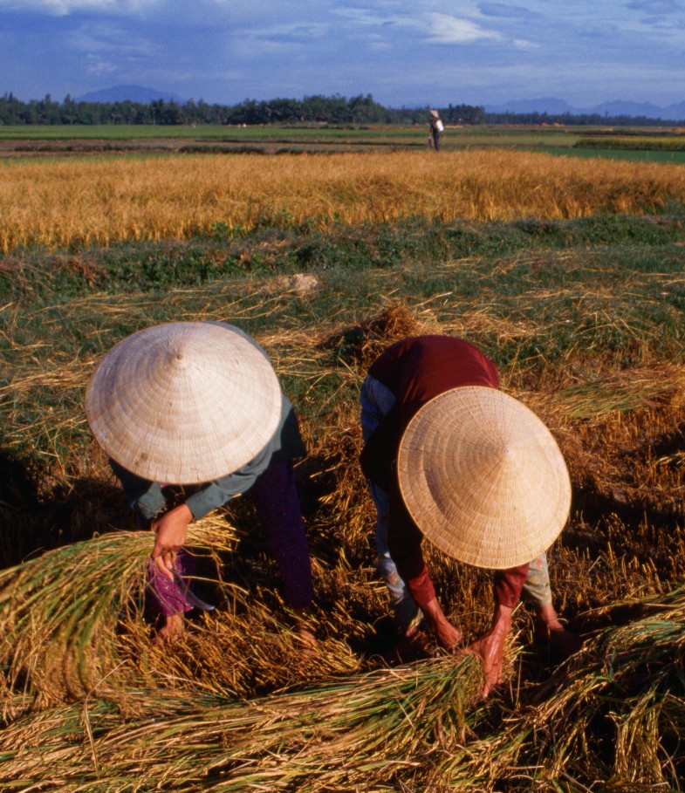
Development Vietnam
Doi Moi
Economic Development
Poverty Reduction
Starting point ‘80s bad

Slide 5
Total Trade

Slide 6
Agricultural Trade

Slide 7
Agricultural Productivity
Productivity

Slide 8
Development agricultural area

Slide 9
Poverty reduction
Poverty head count (GSO/WB poverty line) | 1993 | 1998 | 2002 | 2004 | 2006
National | 58.1 | 37.4 | 28.9 | 19.5 | 15.9
Urban | 24.9 | 9.2 | 6.7 | 3.6 | 3.6
Rural | 66.4 | 45.5 | 35.6 | 25.0 | 19.8

Slide 10
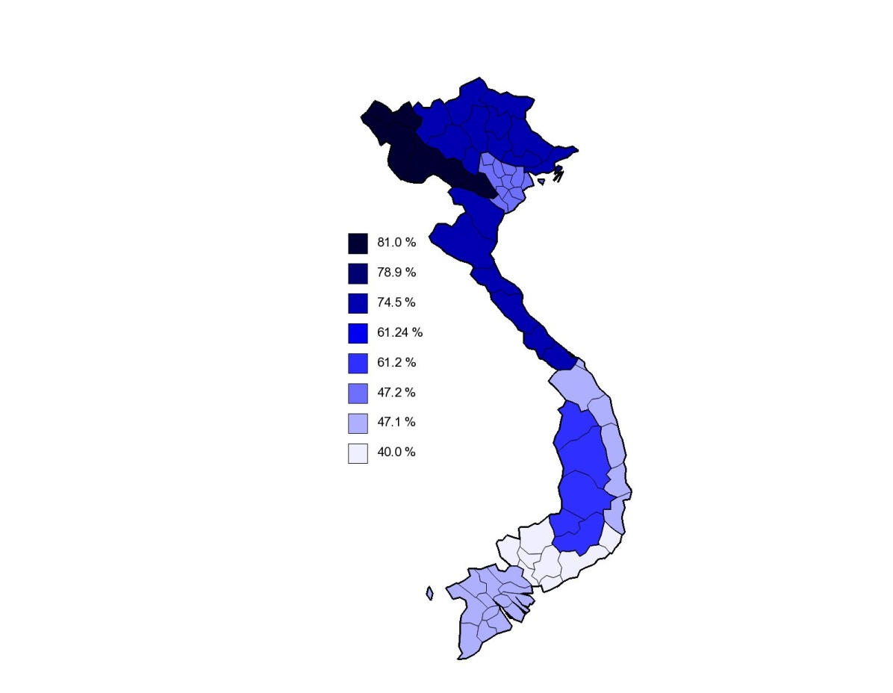
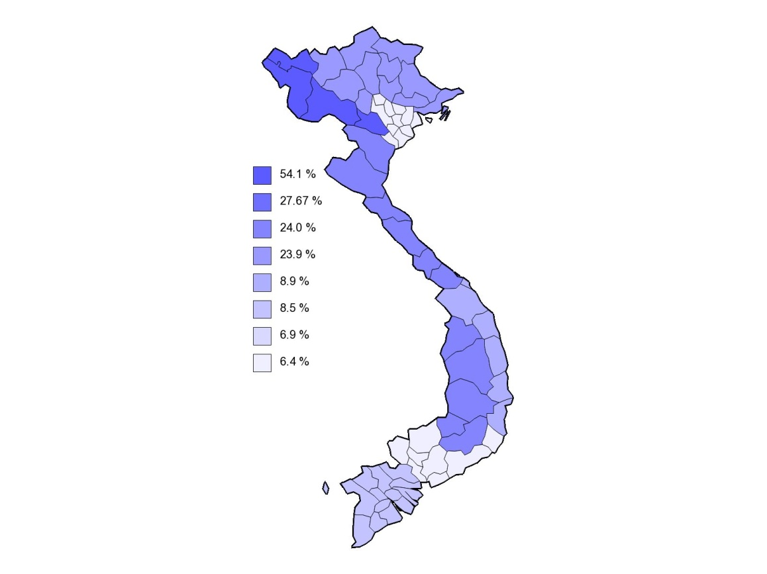
1993
2006
North East
North East
North West
North West
Red River Delta
Red River Delta
North Central Coast
North Central Coast
South Central Coast
South Central Coast
Central Highlands
Central Highlands
South East
South East
Mekong River Delta
Mekong River Delta

Slide 11
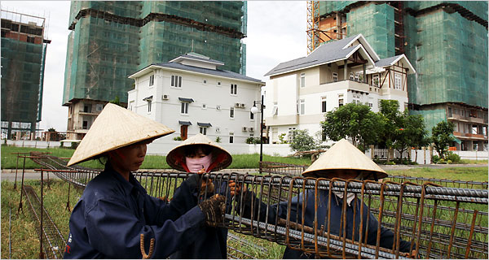
Lessons Learned
Open markets
Devaluation
Decollectivisation
Landrights
Investing in agriculture
Agricultural Research
Induced innovation, technologies on the shelf
“Fairness of the reforms”

Slide 12
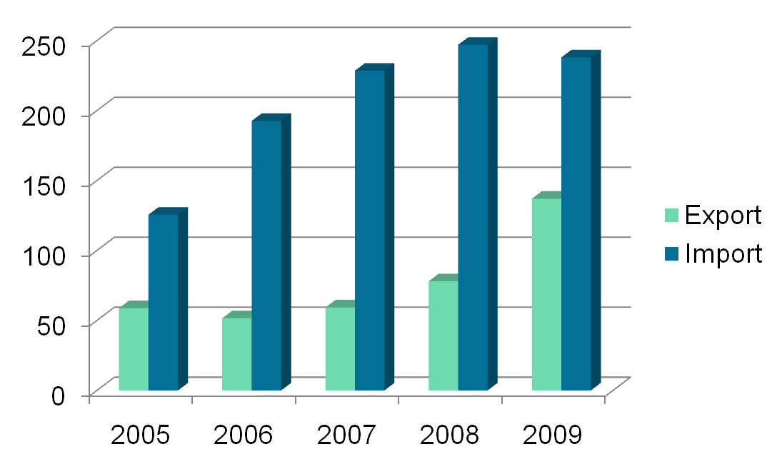
Agricultural Trade between Vietnam and the Netherlands

Slide 13
LNV Beleid
Composition agricultural import from Vietnam

Slide 14
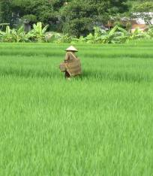
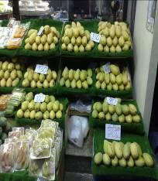
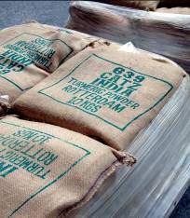
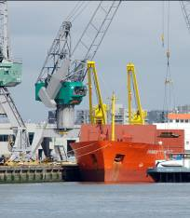

Sustainable Trade Chains

Slide 15
Public Private Cooperation
More market access of sustainable produced agricultural products to The EU from Developing countries
Government
NGO’s
Private sector

Slide 16
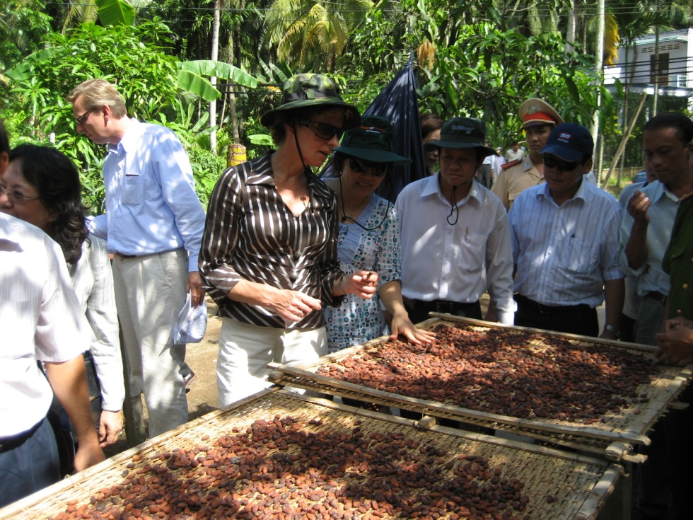
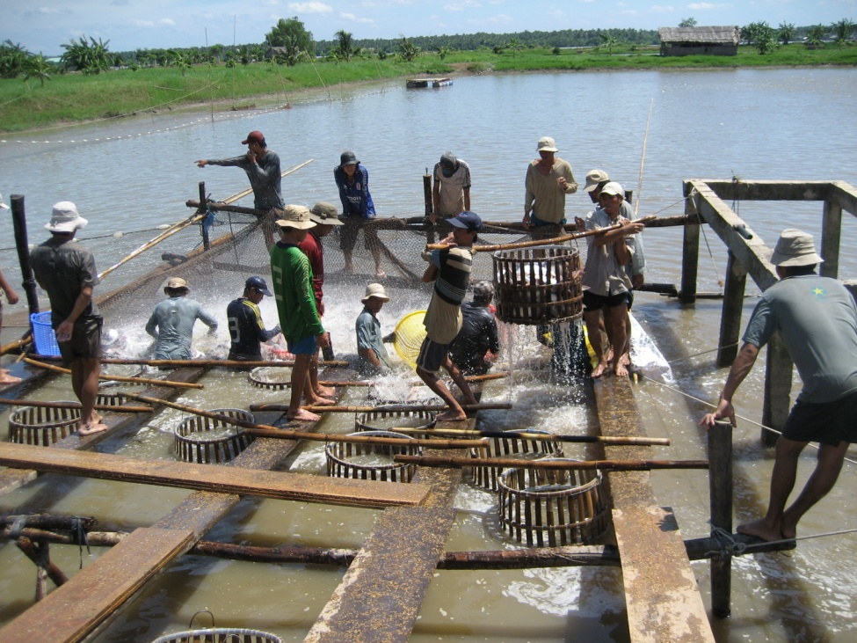
Public Private Partnerships
PPP coffee and cocoa since 2007
PPP Fisheries since 2004

Slide 17
Background Public Private Partnerships
WSSD, World Summit on Sustainable Development Johannesburg 2002
Agricultural Trade and economic development can play a major role in achieving sustainable development and eradicating poverty
Trade not aid
It cannot be without an increased role of the private sector
Complex and interdependent world requires various sectors to come together to effectively respond to development challenges – no one can do it alone

Slide 18
What is a Partnership?
A collaborative alliance between two or more actors, be it public, private or NGOs or any group of individuals which could fundamentally have different objectives, values, cultures, structures, but that are sharing risks, responsibilities, resources and competencies while committed to a common task which will also help to achieve their specific individual goals.

Slide 19
Key Partnership Principles
Partnership greater than sum of its parts
Clear & frequent communication - Transparency
Sharing of risks
Ensure benefits for all partners
Clear, measurable goals
Strive to ensure equity among partners
Complementary contributions - build on core strengths of partners
Agreed partnership governance structure is key for success
Patience!

Slide 20
New Partnership Culture requires
Partnerships start “at home” – staff, culture, finance
‘Extroverted’ networking culture, client focus
Listening skills – understand different cultures
Flexibility, adaptability
Connecting, sharing, reporting – internally & externally – knowledge management
Responsive leadership, real-time decision making
Not an add-on – the way we do our work!

Slide 21
Development Cooperation
Support to health, fight against hiv/aids, drinking water
Trade and investment promotion
Political dialogue
Support to forestry, water resource management
Police cooperation
Consular affairs
Increasing food safety
Attract Vietnamese students
Anti-corruption
Private sector development
Support to higher education
Donor
Broker
Partner

Slide 22
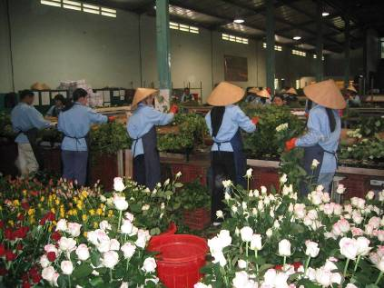
Future cooperation: horticulture

Slide 23
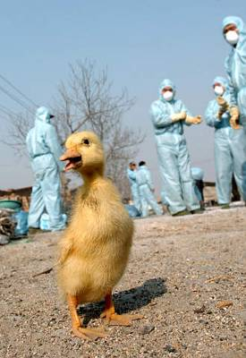
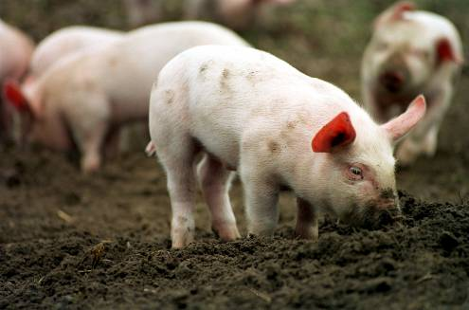
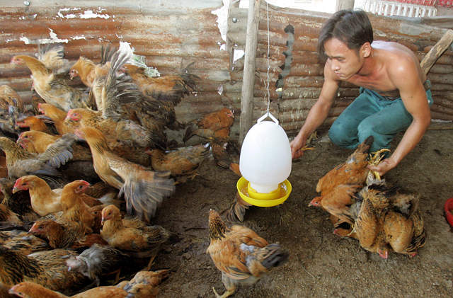
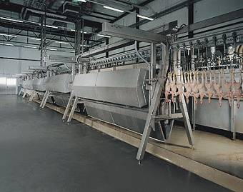
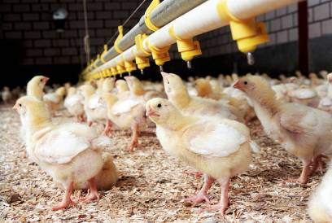
Development of the pigs and poultry industry

Slide 24
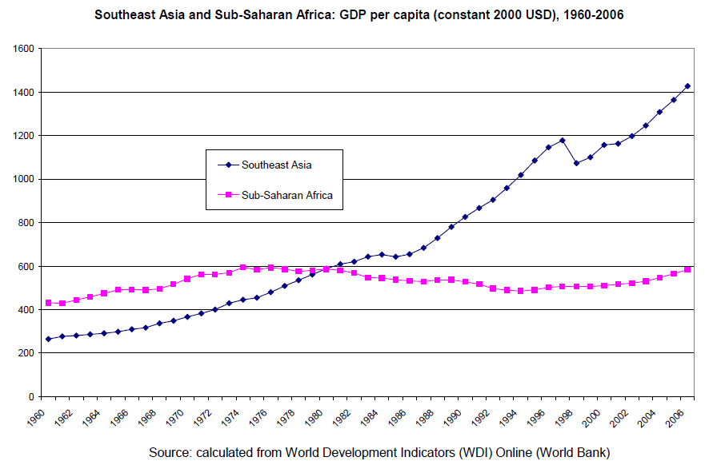
Tracking Development

Slide 25
Tracking development
Conclusion
Sustained poverty reduction takes place in any country where the following three preconditions are all simultaneously and consistently met: 1) adequate macroeconomic management; 2) economic freedom for peasants and small entrepreneurs; 3) pro-poor, pro-rural public spending.
Conclusion: State-led rural and agricultural development, leading to higher incomes for peasant farmers, has been crucial to Southeast Asia's success, and we infer that its absence has also been crucial to Sub-Saharan Africa's failure.

Slide 26

Agriculture is part of the solution!

